Slide 1
Logistics Optimization for Delivery Routes – Amazon
SQL-Based Analytics Project
Kshitiz Prakash

Slide 2
Project Overview & Objective
Amazon handles high-volume logistics operations
Delays increase costs and reduce customer satisfaction
SQL used to analyze:
Delivery Delays
Route Efficiency
Warehouse & agent performance

Slide 3
Dataset Overview
Table Name | Purpose
Orders | Order & delivery status
Routes | Distance, traffic & region
Warehouses | Processing performance
DeliveryAgents | Agent efficiency
Shipment Tracking | Checkpoint-level data

Slide 4
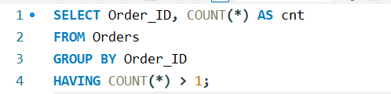
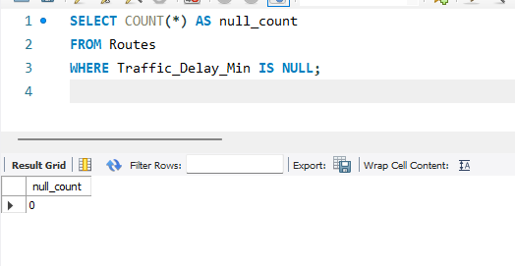
Task 1 – Data Cleaning & Preparation
NULL traffic delay handling:
Duplicate removal :

Slide 5
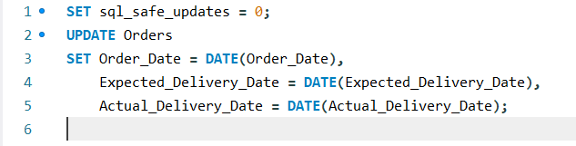
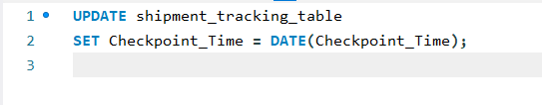
Task 1 – Data Cleaning & Preparation
Date conversion: -
Invalid date flag :-

Slide 6
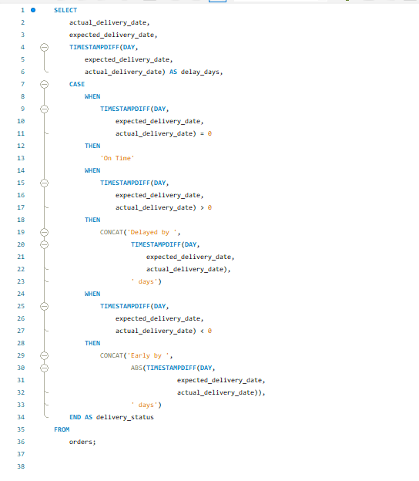
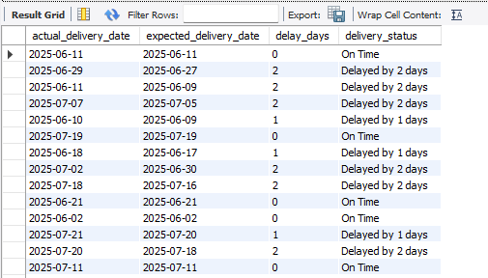
Task 2 – Delivery Delay Analysis
Delay calculation query (output)
Delay calculation query

Slide 7
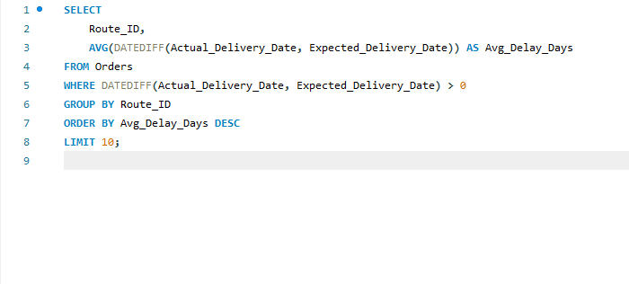
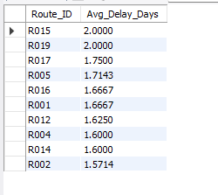
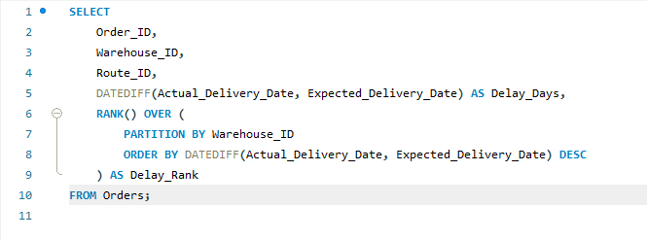
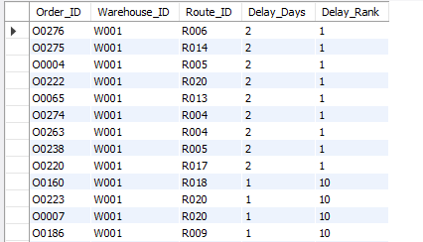
Task 2 – Delivery Delay Analysis
Top 10 delayed routes table query
Top 10 delayed routes table query output
Warehouse-level delay ranking query
Warehouse-level delay ranking query output

Slide 8
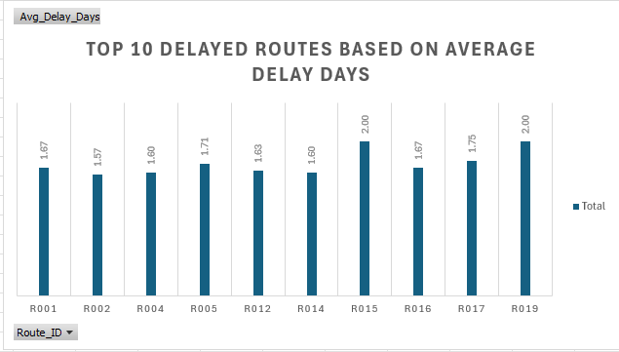
Task 2 – Delivery Delay Analysis
Insights :- Route R019 amd R015 had most number of delays whereas R002 took minimum number of delays .

Slide 9
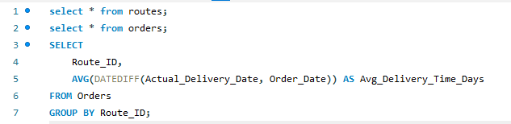
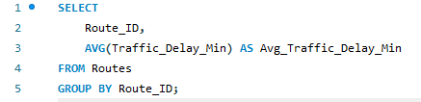
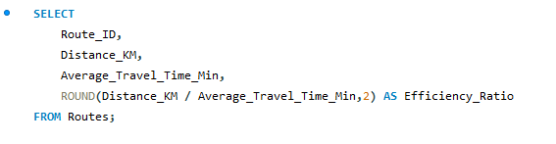
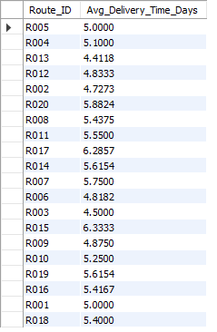
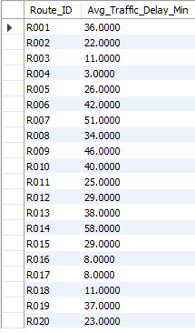
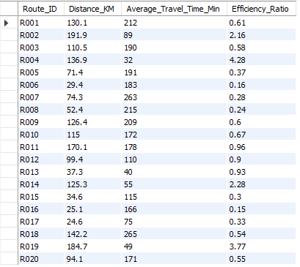
Task 3 – Route Optimization Insights
Average delivery time (in days) query and output
Average delivery min query and output
Distance-to-time efficiency ratio: Distance_KM / Average_Travel_Time_Min.

Slide 10
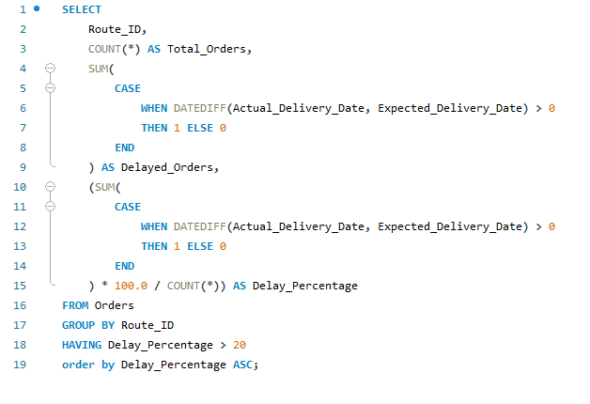
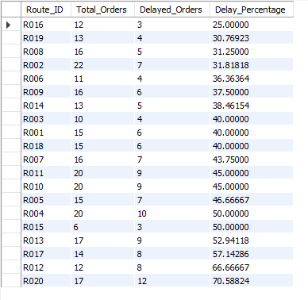
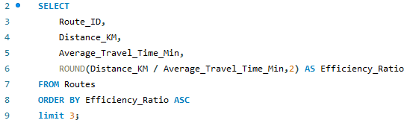
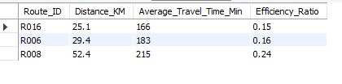
Task 3 – Route Optimization Insights
Find routes with >20% delayed shipments query and output.
Identify 3 routes with the worst efficiency ratio query and output.

Slide 11
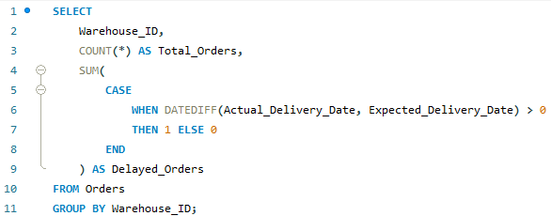
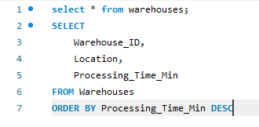
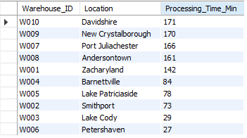
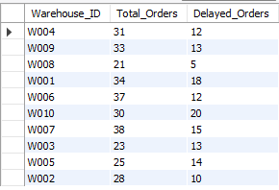
Task 4 – Warehouse Performance
Find the top 3 warehouses with the highest average processing time query and output.
Calculate total vs. delayed shipments for each warehouse query and output.

Slide 12
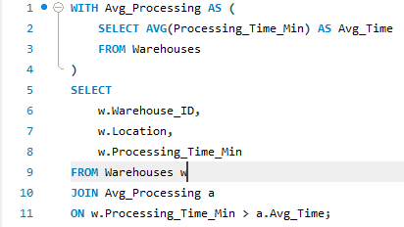
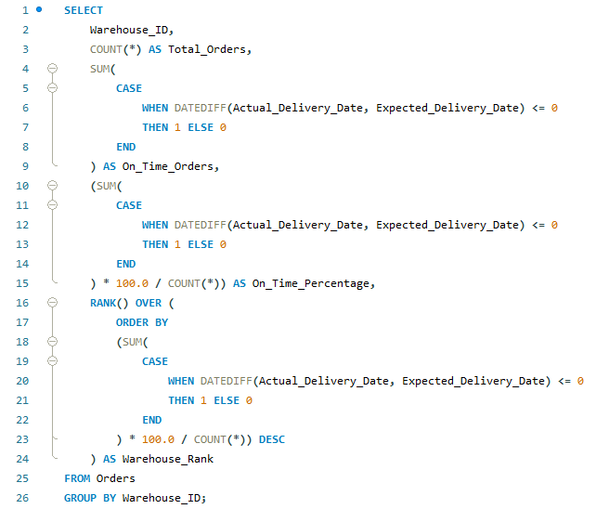
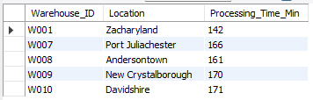
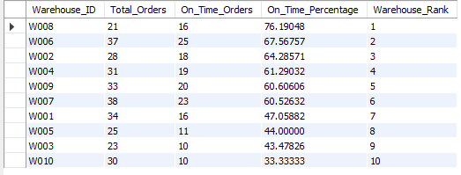
Task 4 – Warehouse Performance
CTEs to find bottleneck warehouses where processing time > global average query and output.
Rank warehouses based on on-time delivery percentage query and output.

Slide 13
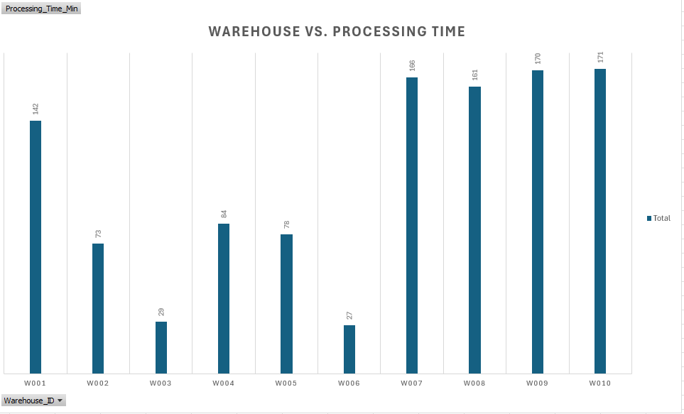
Task 4 – Warehouse Performance
Insights : W010 took most processing time and W006 took least processing time.

Slide 14
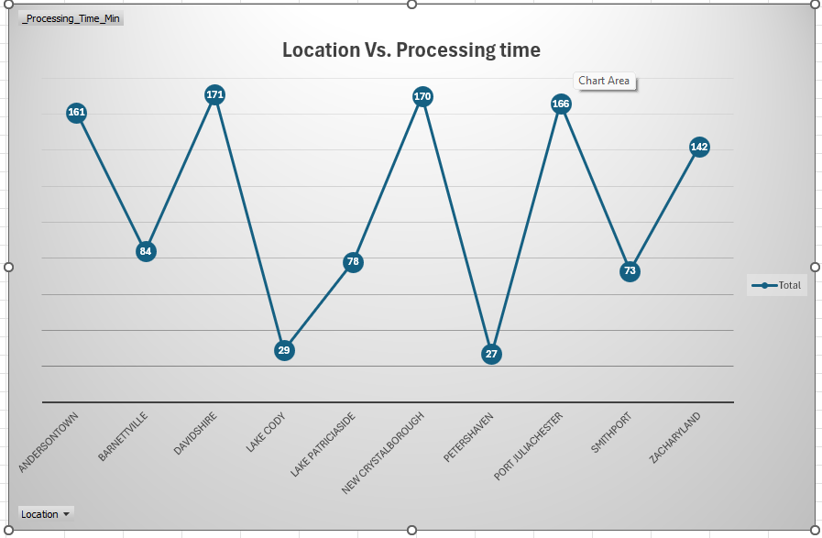
Task 4 – Warehouse Performance
Insights : DAVIDSHIRE took most processing time and PETERSHAVEN took least processing time.

Slide 15
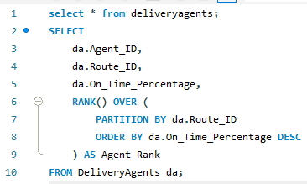
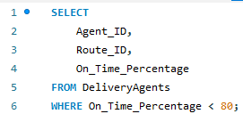
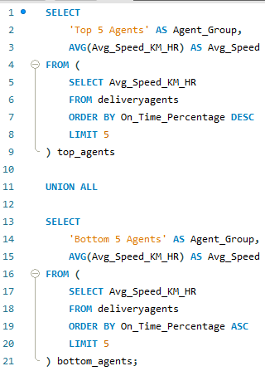
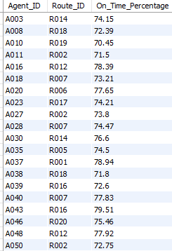
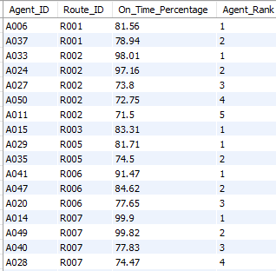

Task 5 – Delivery Agent Performance
Rank agents (per route) by on-time delivery percentage query and output.
Find agents with on-time % < 80% query and output.
Compare average speed of top 5 vs bottom 5 agents using subqueries query and output.

Slide 16
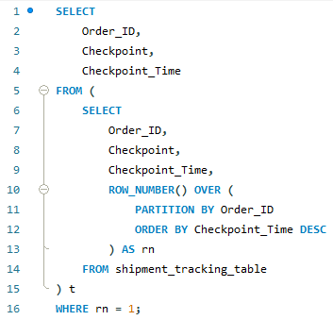
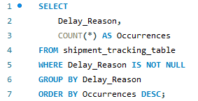
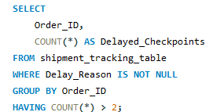

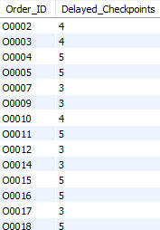
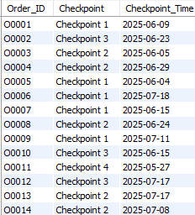
Task 6 – Shipment Tracking Analytics
Find the most common delay reasons query and output.
Identify orders with >2 delayed checkpoints query and output.
For each order, list the last checkpoint and time query and output.

Slide 17
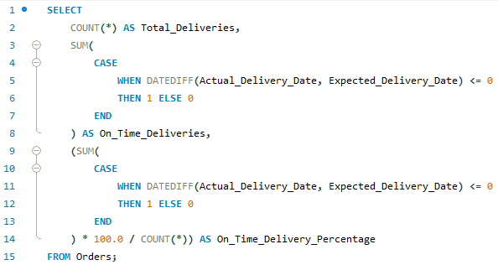
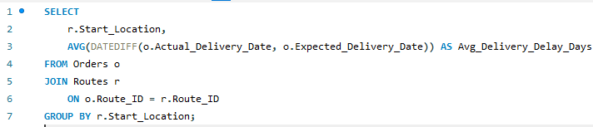
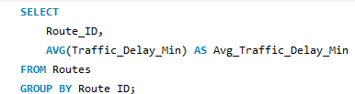
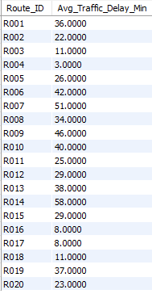
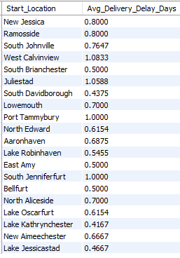

Task 7 – KPI Dashboard
Average Delivery Delay per Region (Start_Location).
Average Traffic Delay per Route.
On-Time Delivery % = (Total On-Time Deliveries / Total Deliveries) * 100.

Slide 18
Link to the video.
https://drive.google.com/file/d/19su64c6xicuPuk-qsKrjKj6YEm1PEozo/view?usp=drive_link

